Slide 1
Review of Lists, Stacks, and Queues
CS 400/600 – Data Structures

Slide 2
The LIST ADT
Fence – a pointer to the current position in the list.
  Example: <20, 23 | 10, 12, 15>
Operations
  insert/remove/getValue – start of the right partition
  Append – end of list
  setStart, setEnd, prev, next, setPos – move the fence
  leftLength, rightLength
  clear, print

Slide 3
Implementation
The LIST abstract data type can be implemented in a variety of ways, including:
  Array
  Linked list

Slide 4
An Array-based LIST
class AList : public List<Elem> {
private:
int maxSize;
int listSize;
int fence;
Elem* listArray;
…
};
7 12 89 3 14 8 5 12
maxSize:
listSize:
fence:
8
6
2
<7, 12 | 89, 3, 14, 8>

Slide 5
Array-based implementation
Delete and insert take Θ(n) time:
// Insert at front of right partition
template <class Elem>
bool AList<Elem>::insert(const Elem& item) {
if (listSize == maxSize) return false;
for(int i=listSize; i>fence; i--)
// Shift Elems up to make room
listArray[i] = listArray[i-1];
listArray[fence] = item;
listSize++; // Increment list size
return true;
}
New value
7 12 89 3 14 8 5 12

Slide 6
Single-linked node
// Singly-linked list node
template <class Elem> class Link {
public:
Elem element; // Value for this node
Link *next; // Pointer to next node
Link(const Elem& elmval, Link* nextval = NULL)
{ element = elemval; next = nextval; }
Link(Link* nextval = NULL) {next = nextval;}
};

Slide 7
Single-linked implementation
// Linked list implementation
template <class Elem> class LList: public List<Elem> {
private:
Link<Elem>* head; // Point to list header
Link<Elem>* tail; // Pointer to last Elem
Link<Elem>* fence;// Last element on left
int leftcnt; // Size of left
int rightcnt; // Size of right
Leftcnt and rightcnt only for efficiency
Pointers only

Slide 8
Single-linked implementation
// Linked list implementation
template <class Elem> class LList: public List<Elem> {
private:
Link<Elem>* head; // Point to list header
Link<Elem>* tail; // Pointer to last Elem
Link<Elem>* fence;// Last element on left
int leftcnt; // Size of left
int rightcnt; // Size of right
Now insert and delete are Θ(1) operations
What about setpos(i)?
What about prev()?
head
23
12
8
62

Slide 9
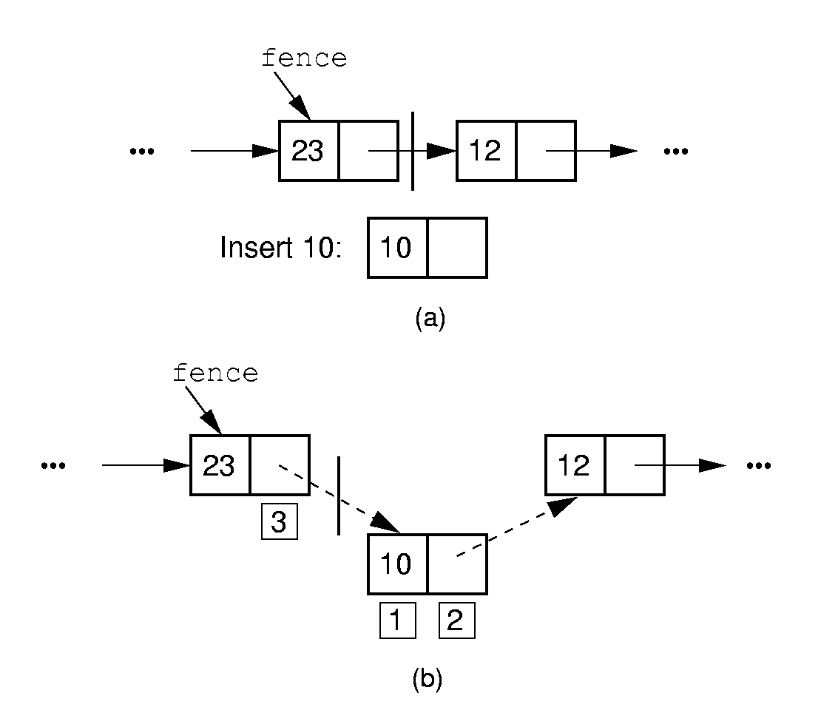
Insertion
// Insert at front of right partition
template <class Elem>
bool LList<Elem>::insert(const Elem& item) {
fence->next = new Link<Elem>(item, fence->next);
if (tail == fence) tail = fence->next;
rightcnt++;
return true;
}

Slide 10
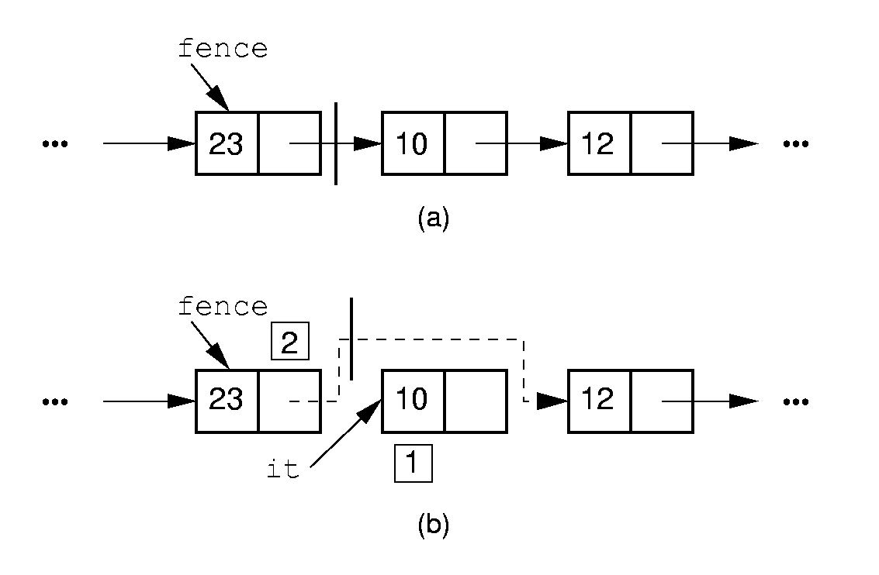
Deletion
// Remove and return first Elem in right partition
template <class Elem> bool LList<Elem>::remove(Elem& it) {
if (fence->next == NULL) return false;
it = fence->next->element; // Remember value
// Remember link node
Link<Elem>* ltemp = fence->next;
fence->next = ltemp->next; // Remove
if (tail == ltemp) tail = fence; // Reset tail
delete ltemp; // Reclaim space
rightcnt--;
return true;
}

Slide 11
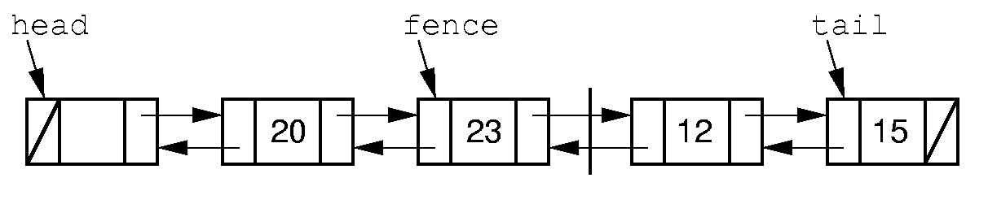
Doubly-linked list
How can we make setpos() and prev() more efficient in terms of time?
  By sacrificing space (space/time tradeoff)
  Each node points to both the next and prev nodes

Slide 12
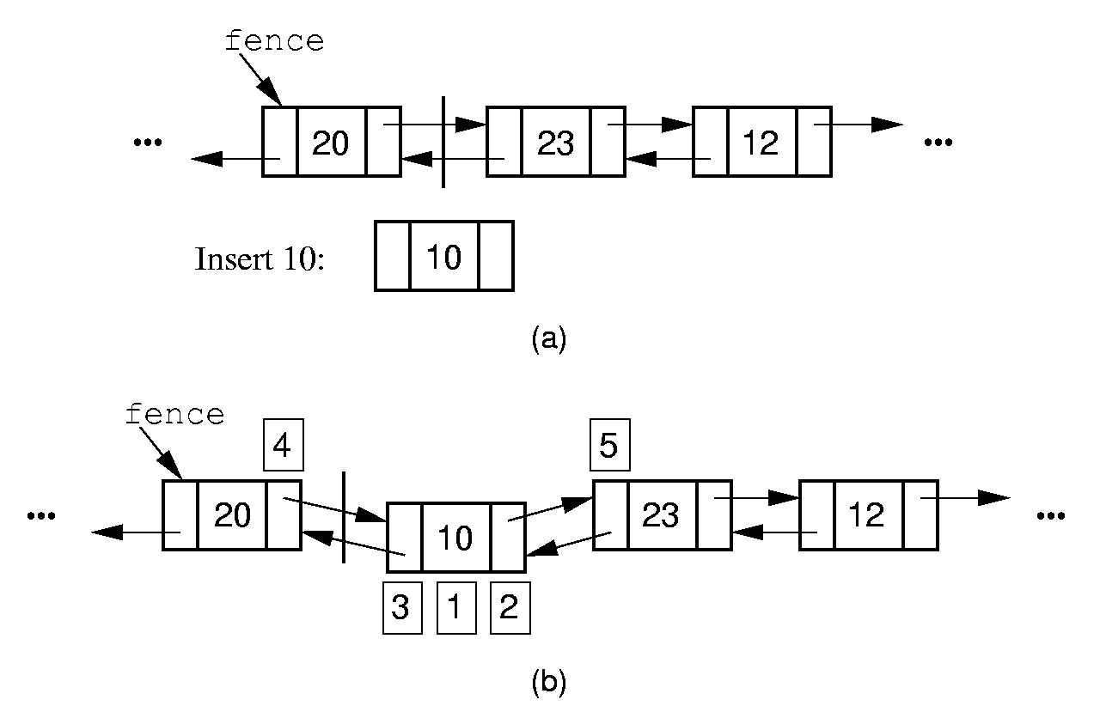
Doubly-linked insert
// Insert at front of right partition
template <class Elem>
bool LList<Elem>::insert(const Elem& item) {
fence->next =
new Link<Elem>(item, fence, fence->next);
if (fence->next->next != NULL)
fence->next->next->prev = fence->next;
if (tail == fence) // Appending new Elem
tail = fence->next; // so set tail
rightcnt++; // Added to right
return true;
}

Slide 13
Comparison of Implementations
Array-Based Lists:
Insertion and deletion are Θ(n).
Prev and direct access are Θ(1).
Array must be allocated in advance.
No overhead if all array positions are full.
Linked Lists:
Insertion and deletion are Θ(1).
Prev and direct access are Θ(n).
Space grows with number of elements.
Every element requires overhead.
Notes:
Applies to both average and worst cases.

Slide 14
Space Comparison
“Break-even” point:
DE = n(P + E);
n = DE
P + E
E: Space for data value.
P: Space for pointer.
D: Number of elements in array.
n: Number of elements in list.

Slide 15
Managing Memory
C++ new() and delete() operations are very expensive in terms of time
We can use a freelist to manage our memory and speed up our implementation
Simple singly-linked list of nodes
Easier than general-purpose memory manager:
  All nodes are the same size
  Always remove from front of list, add to front of list

Slide 16
Freelists
// Singly-linked list node with freelist
template <class Elem> class Link {
private:
static Link<Elem>* freelist; // Head
public:
Elem element; // Value for this node
Link* next; // Point to next node Link(const Elem& elemval,
Link* nextval =NULL)
{ element = elemval; next = nextval; }
Link(Link* nextval =NULL) {next=nextval;}
void* operator new(size_t); // Overload
void operator delete(void*); // Overload
};

Slide 17
Freelists (2)
template <class Elem>
Link<Elem>* Link<Elem>::freelist = NULL;
template <class Elem> // Overload for new
void* Link<Elem>::operator new(size_t) {
if (freelist == NULL) return ::new Link;
Link<Elem>* temp = freelist; // Reuse
freelist = freelist->next;
return temp; // Return the link
}
template <class Elem> // Overload delete
void Link<Elem>::operator delete(void* ptr){
((Link<Elem>*)ptr)->next = freelist;
freelist = (Link<Elem>*)ptr;
}

Slide 18
Stacks
LIFO – Last in, first out
Stack S1;
S1.push(10);
S1.push(12);
S1.push(15)
cout << S1.pop() << S1.pop() << S1.pop();
15 12 10

Slide 19
Array-Based Stack
// Array-based stack implementation
template <class Elem> class AStack:
public Stack<Elem> {
private:
int size; // Maximum size of stack
int top; // Index for top element
Elem *listArray; // Array holding elements
public:
AStack(int sz =DefaultListSize)
{ size = sz; top = 0;
listArray = new Elem[sz]; }
~AStack() { delete [] listArray; }
void clear() { top = 0; }

Slide 20
Array-Based Stack (2)
bool push(const Elem& item) {
if (top == size) return false; // full
else { listArray[top++] = item;
return true; }
}
bool pop(Elem& it) { // Pop top element
if (top == 0) return false;
else {it = listArray[--top]; return true;}
}
// Return top element
bool topValue(Elem& it) const {
if (top == 0) return false;
else {it = listArray[top-1]; return true;}
}
int length() const { return top; }

Slide 21
Linked Stack (1)
template <class Elem> class LStack:
public Stack<Elem> {
private:
Link<Elem>* top; // Pointer to first elem
int size; // Count number of elems
public:
LStack(int sz =DefaultListSize)
{ top = NULL; size = 0; }
bool push(const Elem& item) {
top = new Link<Elem>(item, top);
size++;
return true;
}

Slide 22
Linked Stack (2)
bool pop(Elem& it) {
if (size == 0) return false;
it = top->element;
Link<Elem>* ltemp = top->next;
delete top;
top = ltemp;
size--;
return true;
}
bool topValue(Elem& it) const {
if (size == 0) return false;
it = top->element;
return true;
}

Slide 23
Queues
FIFO: First in, First Out
Restricted form of list: Insert at one end, remove from the other.
Notation:
Insert: Enqueue
Delete: Dequeue
First element: Front
Last element: Rear

Slide 24
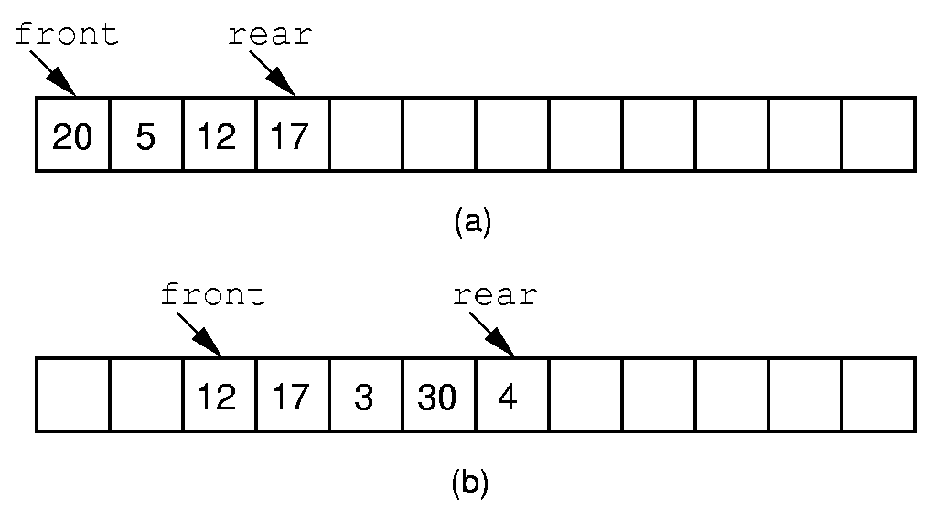
Queue Implementation (1)
Insert and delete are Θ(1), but the queue drifts towards the end of the array…
Notes:
If we stick to the requirement that the queue elements be at the beginning n elements of the array, then either enqueue or dequeue must be θ(n).
Better is to let the elements “drift” within the array.
Unfortunately, as items are added and removed, the queue “drifts” toward the end. Eventually, there will be no space to the right of the queue, even though there is space in the array.

Slide 25
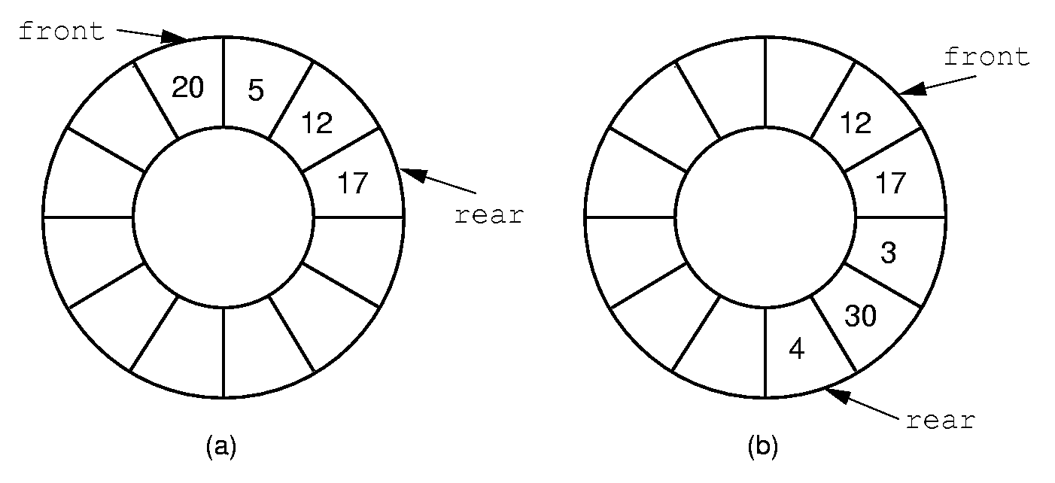
Queue Implementation (2)
How can we tell if the queue is full?
  Pigeonhole principle
  n-1 elements, or an explicit count member variable
Notes:
By using the mod function, we can easily achieve the effect of a “circular” queue.
This leaves one more issue. Where do the front and rear pointers go (point to the item? Or to the space before/after the item)? And, how do we distinguish a full from an empty queue?
Given a fixed position for the front element (and its pointer), there are n-1 possible states for the queue (0 through n elements in the queue for an array of size n), but only n possible positions for rear. To solve this dilemma, we must either leave an empty slot in the queue, or use and external variable to determine if the queue is empty or not.

